Slide 1
Integrin-binding elastin-like polypeptide as an in situ gelling delivery matrix enhances the therapeutic efficacy of adipose stem cells in healing full-thickness cutaneous wounds
Paper seminar
Nasrul Wathoni
January 13, 2017
Seong-Kyoon Choi ^{a,1}, Jin-Kyu Park ^{a,d,1}, Jung-Hee Kim ª, Kyeong-Min Lee ª, Enjoo Kim ^{a,b}, Kyu-Shik Jeong ^{d}, Won Bae Jeon ^{a,b,c}
ª Laboratory of Biochemistry and Cellular Engineering, Daegu Gyeongbuk Institute of Science and Technology, Republic of Korea
^{b} Faculty Affiliation to Department of Brain and Cognitive Sciences, Daegu Gyeongbuk Institute of Science and Technology, Republic of Korea
^{c} Faculty Affiliation to Department of New Biology, Daegu Gyeongbuk Institute of Science and Technology, Republic of Korea
^{d} Department of Pathology, College of Veterinary Medicine, Kyungpook National University, Republic of Korea
<< J. Control. Release, 237, 89-100 (2016) >>

Slide 2
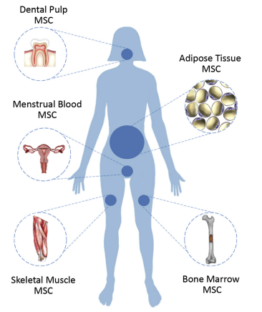
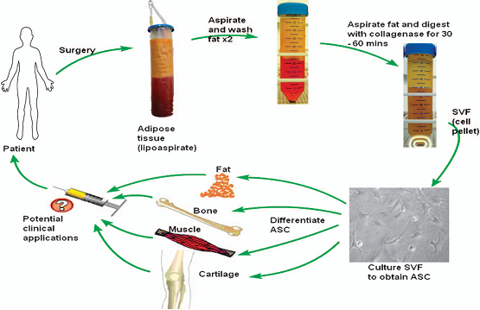
1
Introduction
Adipose stem cells (ASC) are multipotent stromal cells or mesenchymal stem cells (MSC), which are easily available in the stromal vascular fraction from lipoaspirate.
<<A.C. Boquest et al, Methods Mol. Biol., 325, 35–46 (2006). >>
Fig. 2. Illustration stromal vascular fraction (SVF) as source of ASC.
Fig. 1. Illustration of different MSC sources obtained from adult tissues.
<< C. Seretis et al, Obes. Surg., 10, 1950–1955 (2015). >>
<< Goldenberg et al, Academic Press: Boston, 39-63 (2017) >>
The lineage-specific differentiation potential and the ability to suppress host immune responses make ASC an excellent autologous and allogeneic stem cell choice for a wide variety of clinical therapies.
Under specified conditions, ASC differentiate into various cell types of the endodermal, mesodermal, and ectodermal lineages.
<<P.A. Zuk et al, Tissue Eng., 7, 211-228 (2006). >>

Slide 3
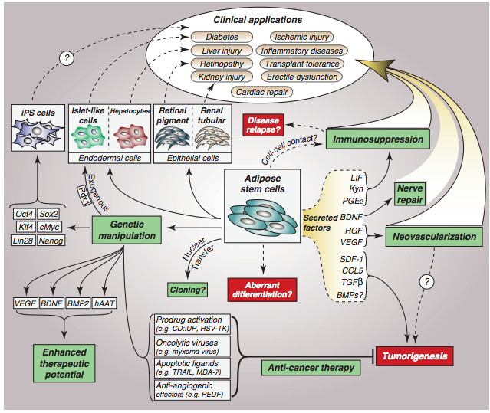
2
Introduction
The promises and pitfalls of adipose tissue stem cells
Fig. 3. The promises and pitfalls of adipose tissue stem cells. Benefits of ASCs are shown in green boxes and potential pitfalls are highlighted in red boxes.
<<P. William et al, Trends Endocrinol. Metab., 23, 270-277 (2012). >>
Notes:
ASC multipotency has recently been extended to include cells of endodermal and ectodermal origin, including renal tubular epithelial cells, retinal pigment epithelial cells, hepatocytes and islet-like cells. The ability to differentiate into these cell types is revealing new potential clinical applications of ASCs, as indicated. Differentiation into isletlike cells has been achieved through specific culturing conditions, or through transduction for expression of Pdx1. Transduction of ASCs for expression of reprogramming factors, such as Oct4, Sox2, Klf4, c-Myc, Lin28 and Nanog, allows generation of iPS cells from ASCs; this may lead to additional clinical applications. However, ASC multipotency carries the risk of aberrant differentiation, resulting in calcification of soft tissues, or cyst formation. Exogenous expression of other genes, such as VEGF, BDNF, BMP2 or hAAT, can also enhance the therapeutic potential of ASCs. In addition, ASCs are being engineered to express anti-cancer genes, such as prodrug converting enzymes, oncolytic viruses, apoptotic ligands and anti-angiogenic effectors. In addition to their multipotency and ease of genetic manipulation, ASCs secrete numerous factors that may exert beneficial or deleterious effects. Thus, ASCs have been reported to stimulate tumorigenesis, at least in part through secretion of SDF-1, CCL5, TGFb and, possibly, BMPs. By contrast, secretion of BDNF is implicated in ASC-mediated nerve repair; HGF and VEGF exert pro-angiogenic effects; and LIF, Kyn and PGE2 mediate immunosuppression by ASCs, although some studies suggest that cell–cell contact is required for ASCs to suppress lymphocyte or peripheral blood mononuclear cell activation. Neovascularization may also underlie the tumorigenic effects of ASCs. In any case, ASC-mediated immunosuppression, neovascularization and, to a lesser extent, nerve repair, are strongly implicated in many of the reported clinical applications of ASCs. hAAT, human alpha-1 antitrypsin; BDNF, brain-derived neurotrophic factor; CCL5, chemokine (C-C motif) ligand 5; CD::UP, cytosine deaminase::uracil phosphoribosyltransferase; BMP, bone morphogenetic protein; HGF, hepatocyte growth factor; HSV-TK, herpes simplex virus thymidine kinase; Klf4, Kru¨ ppel-like factor 4; Kyn, kynurenine; LIF, leukemia inhibitory factor; Lin28, Lin-28 homolog A; MDA-7, melanoma differentiation-associated gene 7; c-Myc, myelocytomatosis oncogene; Nanog, Nanog homeobox protein; Oct4, octamer-binding transcription factor 4; Pdx1, pancreatic and duodenal homeobox 1; PEDF, pigment epithelium-derived factor; PGE2, prostaglandin E2; SDF-1, stromal cell-derived factor-1; Sox2, SRY-box-containing gene 2; TGFb, transforming growth factor-b; TRAIL, TNF-related apoptosis-inducing ligand; VEGF, vascular endothelial growth factor.

Slide 4
3
Introduction
Healing of cutaneous wounds involves a highly coordinated sequence of events.
<<H. Mizuno et al, Stem Cells, 30, 804–810 (2012). >>
Minutes Hours Days Weeks Months
Inflammation
Hemostasis
Platelets Fibrin clot formation
Vasoactive mediator release
Cytokine and growth factor release
Inflammation
Mast cells Platelet-activating mediator release
Vasoactive and chemotactic mediator release
Neutrophils and Chemotaxis, inflammation
Monocytes Killing and phagocytosing, wound debridement
Cytokines and growth factor release
Proliferation
Skin resurfacing
Keratinocytes Reepithelialization
Dermal restoration
Endothelial cells Angiogenesis
Fibroblasts Fibroplasia
Remodeling
Keratinocytes Epidermis maturation
Myofibroblasts Wound contraction
Apoptosis and scar maturation
Endothelial cells Apoptosis and scar maturation
Fig. 4. Major Cells and Their Effects on Normal Wound Healing
<<A. Gosain et al, World J. Surg., 28, 321–326 (2004). >>

Slide 5
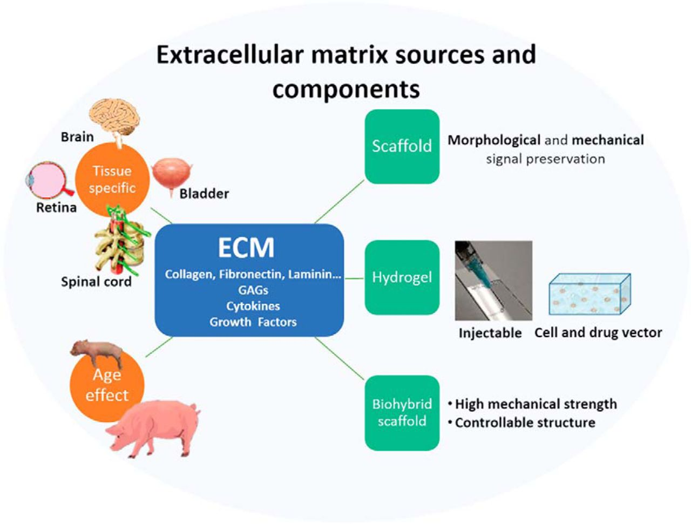
4
Introduction
Any miscue of events could lead to healing failure, resulting in pathologic conditions such as fibrosis and chronic non-healing ulcers.
Many favorable effects of ASC on the healing of acute and chronic wounds have been observed in a number of clinical trials.
The loss of stem cell population after in vivo transplantation remains a challenging problem.
Matrix-induced signal transduction constitutes a critical determinant of cell viability.
<<T.Y. Ren. eneuro, 2, 1-7 (2015)..>>
Use of native ECM (extracellular matrix) materials procured from human or animal tissues is a reasonable approach to sustain the survival of ASC after transplantation. However, employing natural matrix scaffolds includes the inherent risks of immune rejection and pathogen transmission.
Notes:
ECMs can be derived from different animal tissues or organs, each with a unique compliment of proteins, carbohydrates, extracellular matrix molecules, growth factors, and cytokines. The ECM is a flexible platform that can be used as a natural material bioscaffold, an injectable hydrogel, or combined with polymeric materials to form biohybrid devices with controllable mechanical and biochemical properties. Each form can be augmented with cells or other bioactive molecules to improve the healing response.

Slide 6
5
Introduction
Genetically-engineered protein-based polymers (GEPBP)
One of the protein based polymers (PBP) groups currently in the focus of attention of many research teams are genetically-engineered protein-based polymers (GEPBP).
GEPBP are built from repeated sequences of the basic building units (blocks containing from two to several hundred amino acids) that can occur in a polymer molecule in quantities ranging from a few to a few hundred repeats.
<<T. Kowalzyk et al, World J. Microbiol. Biotechnol. 8, 2141–2152 (2014). >>
The strategy of biosynthesis (GEPBP) comprises several stages
(1) designing a protein with the desired properties and its expression cassette
(2) building a gene encoding a protein with the appropriate amino acid composition.
Short fragments of DNA (up to 100 nucleotides) are most often synthesized chemically, then assembled into longer sequences encoding the desired polypeptides with the right mass in the process of concatenation of oligonucleotides or recursive directional ligation, amongst others.
<<D. Chow et al, Mater Sci Eng R Rep. 4, 125-155 (2008). >>
(3) transformation of competent cells with a recombinant vector containing a gene encoding the polymer
(4) analysis the transformed cells for the presence of the introduced construct and confirming the correctness of its structure,
(5) expression of the gene in the right platform and scale
(6) protein purification from the cell lysate or culture medium.
<<L. Mi. Biomacromolecules. 7,2099-2107 (2006).>>

Slide 7
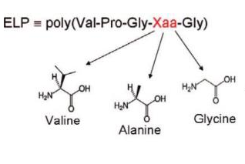
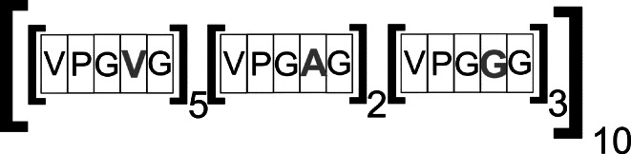
6
Introduction
Elastin-like polypeptides (ELP)
ELP are a family of GEPBP composed of elastin-derived VPGXG (Val–Pro–Gly–Xaa–Gly) pentapeptides, which naturally occurs in the hydrophobic sequence of the domain of a human protein: tropoelastin, (Mr = 60–72 kDa), where X can be any amino acid except for proline.
<<D.T. McPhersson et al, Protein Expr. Purif., 7, 51–57(1996) . >>
Elastin
Elastin is the extracellular matrix protein responsible for the elasticity of vertebrate arterial vessels, connective tissues, lung, and skin.
Elastin resilience is afforded by the formation of insoluble fibers, the first step of which involves the self-alignment of elastin monomers, tropoelastin, in a temperature-induced transition known as coacervation, through the association of hydrophobic domains.
Classification of ELP
<<L.D. Muiznieks et al, J. Bio. Chem. 285, 39779-39789 (2010). >>
The classification of elastin-like polypeptides in the literature is based on the kind and number of amino acids occurring in the guest residue position.
In order to simplify and standardize the notation of the structure of a particular ELP, the following scheme has been agreed upon: [X_{i}Y_{j}Z_{k}-n], where:
X, Y, Z—single-letter symbols of amino acids occurring in the place of the guest residue in the pentamer;
i, j, k—the ratio in which the amino acids occur in the guest residue position in the basic structural unit;
n—the total length describing the number of polypeptides contained in the given ELP.
Fig. 5. The scheme describing the structure of ELPs
<<M.B. van Eldijk et al, Top Curr. Chem., 310, 71–116 (2012). >>
<<A. Valiaev et al, J. Am. Chem. Soc.,130, 10939–10946 ( 2008). >>
Notes:
Maintenance of structural heterogeneity and dynamics of the elastin backbone is achieved in large part by a high proportional composition of both proline (14%) and glycine (35%) residues within hydrophobic sequences (6, 14). These residues are commonly arranged into repeated motifs based on recurring sequence elements such as PGV and GVA. This includes a seven-fold tandem PGVGVA repeat in domain 24 of the native human elastin sequence (15). Contrary to enhancing coacervation or elastomeric properties, the multiple substitution of glycine residues for prolines within tandem repeat sequences (e.g. PGVGVA to GGVGVA) results in the formation of amyloid-like fibrils, rich in β-structure, from solution (6, 14). These structures are conformationally more restricted than native elastomeric sequences as a result of the tighter packing of residues into extended secondary structures and concomitant reduction of backbone hydration (6). Interestingly, human elastin domains 28 and 30, which are glycine-rich and relatively proline-poor, form similar amyloid-like fibrils in isolation (16,–18).
Examination by Rauscher et al. (6) of the proline and glycine content of a wide range of elastomeric and amyloidogenic sequences revealed that a combined PG proportion of (2P+G) > 0.6 correlates with elastomeric assembly. From a functional perspective, an increase in conformational order is generally associated with greater fiber stiffness, as evidenced by hydrated spider silks of decreasing proline content (19,–21). These data suggest that sequence elements and structural motifs play important roles in modulating alignment and assembly propensities and that precise regulation of PG composition is crucial for generating fibers with the required combination of elasticity and strength.

Slide 8
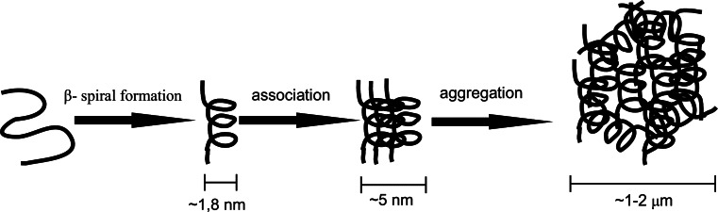
7
Introduction
Physical properties of ELP
The favorable feature of ELP is their responsiveness to a change in solution temperature: above a characteristic transition temperature (Tt), solubilized ELP form highly hydrated hydrogel-like aggregates.
In solutions with a temperature lower than T_{t}, free polymer chains remain in an unordered state showing full hydration (the soluble form). In solutions with temperatures exceeding T_{t}, the situation is different: polymer chains show a more ordered structure (known as the β-spiral), stabilized by hydrophobic interactions.
Fig.6. The ELP aggregation mechanism
<<J.C. Rodriguez-Cabello et al, J. Biomater. Sci. Polym.,18, 269–286 (2007). >>
Different substitutions of the guest residue allow ELP to be designed with the desired T_{t}. Using amino acid residues containing groups susceptible to ionization results in a polymer with a T_{t} regulated by a change in pH, while using an amino acid with a chemically reactive side chain allows ELP to be conjugated with other molecules.
<<R.A. McMillan et al, Macromolecules, 33, 4809–4821 (2000). >>
Notes:
The phase transition temperature level of elastin-like polypeptides depends on a few factors: the concentration of ELP in the solution, the ionic strength of the solution and the molecular mass of the polymer. Along with an increase in these parameters, the phase transition temperature decreases. The presence of different amino acids in place of the guest residue influences the level of T_{t} of a given biopolymer. A hydrophobic group in this position lowers the phase transition temperature, while a hydrophilic group increases it (the effect depends on the molar ratio of particular residues) (McMillan et al. 1999). Different substitutions of the guest residue allow ELP to be designed with the desired T_{t}. Using amino acid residues containing groups susceptible to ionization results in a polymer with a T_{t} regulated by a change in pH, while using an amino acid with a chemically reactive side chain allows ELP to be conjugated with other molecules (McMillan et al. 1999; McMillan and Conticello 2000).

Slide 9
8
Introduction
ELP are non-toxic to cells and tissues and are easily biodegradable, and can be processed into various types of formulations such as in situ aggregates, microfibers, cell sheets, hydrogels, and fusion with growth factors to support different cell types, thus, their contribution to the repair of cartilage, blood vessels, neurons, and heart is beginning to emerge.
Both biological and mechanical properties of ELPs can be readily tailored at the gene level to satisfy end-user applications, thus offering numerous choices for the development of cell culture matrices for tissue engineering.
<<M. Mie et al, J. Biomed. Mater. Res. B Appl. Biomater., 86, 283-290 (2008). >>
However, ELPs containing a neutral or hydrophobic amino acid residue in the guest position X are limited in their usage for cell growth or tissue regeneration due to their low binding affinity to mammalian cells
Therefore, modification of the VPGXG backbone with cell-adhesive sequences has been a major issue in developing ELP-based ECM analogues.
<<W.B. Jeon et al, BMC Biotechnol. 12, 61 (2012). >>
An RGD (ArgGlyAsp) tripeptide derived from fibronectin, vitronectin, or laminin, is a potent integrin-binding ligand associated with adhesion-mediated cell migration and is involved in neurite elongation during neuronal cell differentiation
<<S.L. Roger et al, J. Cell Biol., 105: 1435-1442 (1987). >>

Slide 10
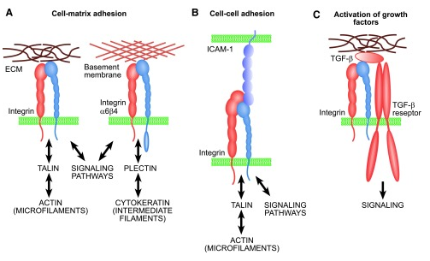
8
Introduction
Integrins in wound healing
Integrins are transmembrane receptors that are the bridges for cell-cell and cell-ECM interactions.
Regulation of cell adhesions during tissue repair is fundamentally important for cell migration, proliferation, and protein production.
All cells interact with ECM proteins with cell surface integrin receptors that convey signals from the environment into the nucleus, regulating gene expression and cell behavior.
Integrins also interact with a variety of other proteins, such as growth factors, their receptors, and proteolytic enzymes.
Fig.7. Basic functions of integrins. (A) Integrins mediate cell adhesion to ECM and form adhesion plaques and intracellular complexes with cytoskeletal and signaling proteins. Most integrins are connected to actin microfilaments, whereas hemidesmosomal α₆β₄ integrin is linked to cytokeratins via plectin protein. (B) Leukocyte integrins can mediate cell–cell adhesion. (C) Integrins also have numerous other functions, such as binding to growth factors. For example, integrins α_{v}β₆ and α_{v}β₈ are critical for in vivo activation of TGF-β1.
Re-epithelialization and granulation tissue formation are crucially dependent on the temporospatial function of multiple integrins.
<<L. Koevisto et al, Adv Wound Care, 12), 762–783 (2014).>>

Slide 11
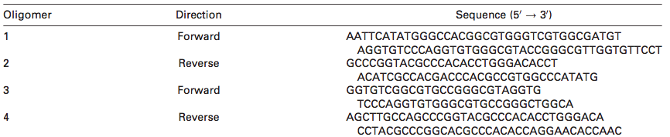
9
Introduction
In previous study
Jeon et al. successfully prepared an RGD-containing elastin-like polypeptide (REP), TGPG[VGRGD(VGVPG)₆]₂₀WPC, referred to as [RGD-V₆]₂₀, contains multiple RGD motifs to bind cell-surface integrins, which regulates diverse cellular functions, such as cell adhesion, migration, proliferation, and differentiation in a manner similar to that of fibronectin.
Monomer gene construction and oligomerization of VGRGD(VGVPG)₆
<<W.B. Jeon et al, BMC Biotechnol. 12, 61 (2012). >>
Table 1. The Oligonucleotides Encoding VGRGD(VGVPG)₆
Table 1 summarizes the sequences of the oligonucleotides for the VGRGD(VGVPG)₆ genes together with the EcoRI, NdeI, PflMI, BglI, and HinDIII restriction enzyme sites (NEB).
1.Mixing
2. Cooling
Oligonucleotides 1, 2, 3, and 4
95°C, 5 min
A double-stranded DNA cassette
r.t, 1°C/min
Cloning vector pUC19
3. Digestion,
dephosphorylation
ligase buffer
CIP
EcoRI, HinDIII
6. Diagnostic digestion
5. Heat shock method
4. Purification, ligation
gel extraction kit
Linearized
pUC19
[VGRGD(VGVPG)₆]_{n}
EcoRI, PflMI, and HinDIII
E. coli Top 10 cells
double-stranded DNA cassette of the VGRGD(VGVPG)₆ gene
The genes for [VGRGD(VGVPG)₆]_{n}, where n 1⁄4 10, 12, 15, and 20, were prepared from a plasmid containing the VGRGD(VGVPG)₆ gene by using recursive directional ligation.
Notes:
Recursive directional ligation is a process with a number of stages. Its first step consists of introducing a synthetic oligonucleotide cassette, which encodes a DNA monomer with two different endonuclease recognition sites (RE1 and RE2), to the vector. The sites are designed to generate complementary sticky ends, with these ends created after linearization of the vector with the RE1 restrictase. The next step is cutting the recombinant vector using both or just one restriction enzyme. The products created are then used for another ligation. The recombinant vector, which contains the repeated DNA monomer sequence flanked with the sites for restriction enzymes R1 and R2, does not reconstruct the restriction site for these endonucleases between them. The next rounds of digestion and ligation with the use of mono- or polymeric gene sequences lead to the generation of an increasing number of repeats of the initial DNA monomer. In this way it is possible to obtain a matrix for the synthesis of a protein polymer of the desired length. The strategy described above puts certain restrictions on the choice of sites recognized by the restriction enzymes: (1) It is necessary to choose sequences recognized by different enzymes, so as to make selective cutting with either one or two endonucleases possible, (2) the enzymes must generate complementary sticky DNA ends, (3) one of the chosen restriction sites cannot occur in the initial vector, (4) the sequences recognized by both enzymes must encode the amino acid sequence of the polypeptide. Recursive directional ligation is a quick and easy method for generating a library of genes encoding protein polymers with diverse molecular mass. Using one vector, it is possible to double the size of the gene with every round of RDL. Such an approach is the quickest method of synthesis in the case of genes with a large number of monomer units. Recursive directional ligation rivals other strategies for assembling synthetic genes encoding proteins with a repetitive structure because: (1) a polymer with the molecular mass needed for the applications in question is produced, (2) each RDL round generates identical DNA oligomers, thus eliminating the necessity of their multiple sequencing (with the exception of a small number of multimers created in the initial stages of the reaction), (3) a library of potentially useful, smaller genes is created in the process of assembling large genes, (4) monomers or oligomers encoding different peptides or proteins can be freely joined in every repeat of the reaction, which allows the structural diversity of the polymer to be increased (McDaniel et al. 2010b).
Due to certain cloning difficulties, the expression vector contained four and three extra codons at the 5′ and 3′ ends of the SfiI site. Consequently, the expressed proteins had additional TGPG and WPC residues at the N- and C-terminals, respectively.

Slide 12
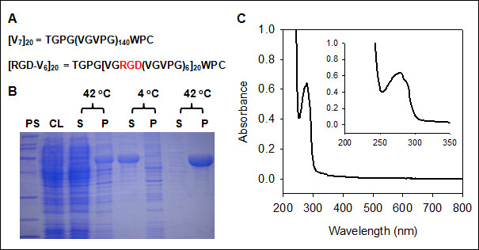
10
Introduction
Purification and characterization of REP ([RGD-V₆]₂₀)
Fig. 8. (A) Amino acid sequences of [RGD-V ₆ ] ₂₀ . (B) SDS-PAGE (sodium dodecyl sulfate-polyacrylamide gel electrophoresis) analysis of [RGD-V₆]₂₀ purification by inverse transition cycling at 42°C and 4°C. (C) UV-visible spectrum of [RGD-V₆]₂₀ in PBS.PS shows MWs of protein standards from top to the bottom: 200, 116, 97, 66, 45, 31, 22 and 14 kDa. CL, S and P represent cell lysate, supernatant and pellet, respectively.
<<W.B. Jeon et al, BMC Biotechnol. 12, 61 (2012). >>
In this study
Jeon et al. hypothesized that infilling wounds with REP aggregates would attract host cell migration from the wound margins while also enhancing the survival of engrafted ASC through cell attachment.
Notes:
The primary structures of [V₇]₂₀ and are shown in Figure 1A. In [RGD-V₆]₂₀, 20 RGD motifs were evenly distributed throughout the whole molecular structure. Typically, from a 40 l fermentation batch of E. coli, approximately 600 g of wet cell cake was obtained. After 3 rounds of inverse transition cycling, 1,036 and 1,080 mg of [V₇]₂₀ and [RGD-V₆]₂₀, respectively, were recovered from a 40 liter batch with a purity greater than 95%, as judged by densitometry on an SDS-PAGE gel (Figure 1B). When a UV-visible spectrum of [RGD-V₆]₂₀ in phosphate-buffered saline (PBS) was scanned from 800 to 200 nm (Figure 1C), its maximum absorbance occurred at 280 nm, and 2 shoulders were detected at 273 (ε = 5,505 M⁻¹ cm⁻¹) and 288 nm (ε = 4,666 M⁻¹ cm⁻¹). No absorbance was detected in the visible region.

Slide 13
11
Purpose and results
[Purpose]
To investigate the potential of an RGD-containing elastin-like polypeptide (REP) with the structure TGPG[VGRGD(VGVPG)₆]₂₀WPC to engraft adipose stem cells (ASC) to full-thickness excisional wounds in mice
[Results]
Fig.1. REP matrix binds ASC and activates adhesion signaling kinases and enhances ASC viability through the activation of Mek/Erk and PI3K/Akt signaling pathways
The interaction of ASC with REP upregulated phosphorylation of Fak and Src kinases and significantly increased Erk and Akt signal transduction in vitro.
Inhibition of Mek/Erk signaling by PD98059 or PI3K/Akt signaling by Wortmannin caused a marked decrease in cell adhesion and cell viability.
Fig.2. Accelerating effect of REP on keratinocyte migration
The migration speed of keratinocyte accelerated in a REP concentration-dependent fashion.
The motility of keratinocytes was shown to be correlated with the dosage of RGD-functionalized REP.
Fig.3. Clearance of REP from the site of injury
The grafted REP remained locally and did not disperse into the intact wound edges.
The majority of grafted REP was dissolved within 5 days and almost completely cleared by 9 days after surgery with a half-life of about 3 days.
The time span of clearance covered the inflammatory and proliferative phases, and partially overlaps with the initial stage of maturation phase of wound healing.
Fig. 4. Quantitative comparison of inflammatory cells and immunological cytokines in the REP-treated mice with the sham control mice.
Excessive local inflammation did not occur after REP application.

Slide 14
12
Results and conclusion
Fig.5. Effects of REP concentration on overall wound closure and dermal tissue regeneration
Wound closure occurred with faster kinetics following REP administration.
Histological analyses indicated a fast transition of granulation tissue into a collagen-rich dermal tissue in the presence of REP.
Table 1. Nucleotide sequence of the primers used for qRT-PCR
The sequences of primer sets used for qRT-PCR were designed using the primer express 3.0 software (Applied Biosystems) based on the mouse gene sequences available from GenBank.
Fig.6. Comparison of overall wound healing between the control group and 100 μM REP group
Following REP treatment, skin tissue regeneration occurred through increased restoration of dermal and epidermal components, not merely by contracting wound edges.
Fig.7. Comparison of wound healing progression among the sham control, REP, ASC, and RA groups over a 2-week period.
The rate of wound closure increased from the REP group to the ASC group, and to the RA group.
Histological analysis of the H&E-stained wound sections indicated that the resto- ration of epidermal and dermal tissues occurred faster in the ASC group than in the other groups at days 1 and 14
Although statistical significance was not achieved, it appeared there was a trend toward a better reepithelialization in the mice treated with RA than the REP and ASC groups.
Western blot analysis showed that α-SMA content was highest in the RA group, meaning that this group had the highest myofibroblast population.
α-SMA content in RA- treated wounds on days 3, 5, and 7 was 1.4-, 1.4-, and 1.2-fold greater, respectively, relative to α-SMA content in wounds treated with only ACS.

Slide 15
13
Results and conclusion
Fig.8. Effects of REP, ASC, and RA on the production of angiogenic factors and on new blood vessel formation
Implanted REP induced higher expression of VEGF, CD31, and VWF, and also promoted new blood vessel formation.
The combination of REP and ASC resulted in a more prominent microvas- culature as compared to treatment with ASC alone
in a tissue section of RA, a single cell in a cross section of newly formed vascular tube exhibited a clear overlap of CD31 and EGFP probes, suggesting a possibility of in situ differentiation of ASC into a vascular endothelial cell type and direct engraftment into the vasculature.
Fig.9. Effect of REP on the survival of transplanted ASC
>90% of the implanted ASC were dead within 5 days, with a massive cell death occurring within 5 days.
The combined therapy of REP and ASC resulted in a 35% improve- ment in cell viability at 1 week after surgery.
Fig.10. Comparison of Erk and Akt phosphorylation during wound repair among the sham control, REP, ASC, and RA groups.
The interaction of ASC with REP significantly increased Erk and Akt signal transduction during wound healing.
CONCLUSION
In conclusion, of the most significant among these findings is the successful implementation of thermoreversible, integrin-binding REP as not only an alternative matrix for replacing of damaged or lost natural ECM, but also as an effective carrier for embedding ASC and enhancing the subsequent in vivo viability of transplanted ASC. A combined therapy of REP and ASC enhances wound healing and regeneration with a clinically noticeable effect. Because the mechanisms for the influence of REP on the combined therapy are through the mobilization of endogenous cells, stimulation of local angiogenesis, and enhancement of engrafted stem cell viability, this mechanistic insight on the REP-mediated delivery system might identify new therapeutic targets that can promote normal tissue regeneration in impaired healing conditions such as chronic neurodegenerative diseases and diabetic ulcers.

Slide 16
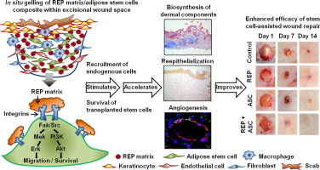
14
Summary
In situ gelling of REP matrix/adipose stem cells
composite within excisional wound space
Biosynthesis of
dermal components
Enhanced efficacy of stem
cell-assisted wound repair
Recruitment of
endogenous cells
Reepithelization
Survival of
tranplanted stem cells
Angiogenesis
One crucial issue in stem cell therapy used for tissue repair is often the lack of selective carriers to deliver stem cells to the site of injury where the native extracellular matrix is pathologically damaged or lost. Therefore, it is necessary to develop a biomaterial that is permissive to stem cells and is suitable to replace injured or missing matrix. The major aim of this study is to investigate the potential of an RGD-containing elastin-like polypeptide (REP) with the structure TGPG[VGRGD(VGVPG)₆]₂₀WPC to engraft adipose stem cells (ASC) to full-thickness excisional wounds in mice. We implanted REP into the wound defects via body temperature-induced in situ aggregation. Engrafted REP exhibited a half-life of 2.6 days in the wounds and did not elicit any pathological immune responses. REP itself significantly accelerated wound closure and reepithelialization and upregulated the expression of dermal tissue components. A combined administration of REP and ASC formed a hydrogel-like ASC/REP composite, which provided better neovascularization than the use of ASCs alone and increased the viability of transplanted ASC, improving overall wound healing. In vitro and in vivo mechanistic investigations suggested that REP enhances ASC survival at least in part via the Fak/Src adhesion-induced upregulation of Mek/Erk and PI3K/Akt survival pathways. We conclude that REP is a promising therapeutic agent for the improvement of stem cell-based therapy for enhanced tissue regeneration and repair.

Slide 17
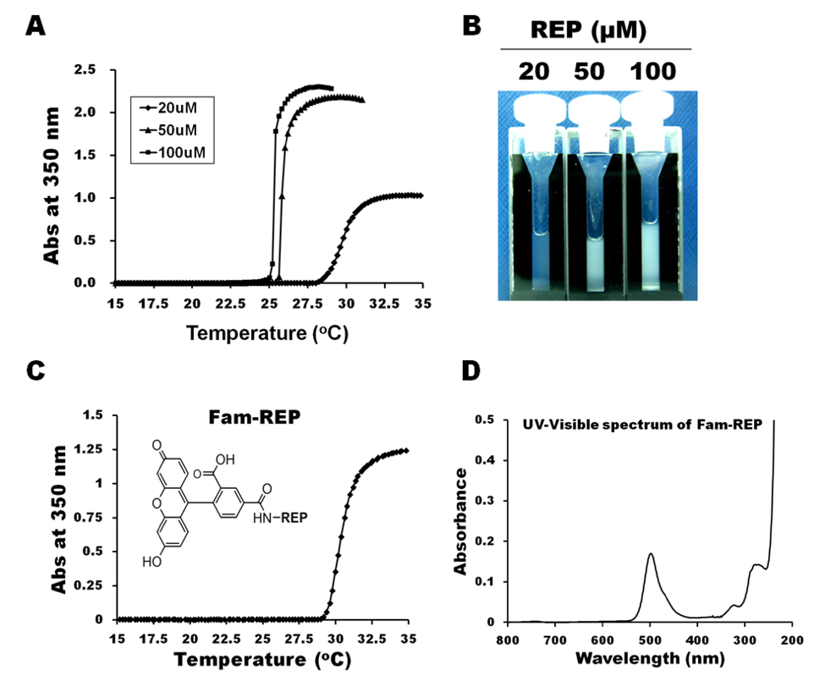
15
Result – Suppl. Fig. 1
Suppl. Fig. 1 A-B
[Purpose]
To investigate phase transition of REP
Suppl. Fig. 1. Phase transition of REP. (A) Inverse temperature transition of REP in the absence of DTT. REP concentrations were 20, 50, and 100 µM in PBS. (B) Images of REP aggregation into coacervates at 37 °C. (C) Inverse temperature transition of 25 mM Fam-REP in the absence of DTT. In (A) and (C), the heating rate was 1 °C/min. (D) UV-visible spectrum of Fam-REP.
Tt values were determined to be 29.7, 25.9, and 25.3°C for 20, 50, and 100 μM REP, respectively. Because these Tt values were lower than the body temperature of mice, the REP solutions spontaneously self-assembled into gel-like aggregates after topical loading into the wound space.
Notes:
Temperature and concentration are two important determinants of REP aggregation [19]. Transition curves of three REP solutions at different concentrations (20, 50, and 100 μM) were characterized. When solution temperature was increased from 15 °C to 35 °C, all three solutions exhibited an elevation in absorbance due to REP aggregation (Suppl. Fig. 1A, B)

Slide 18
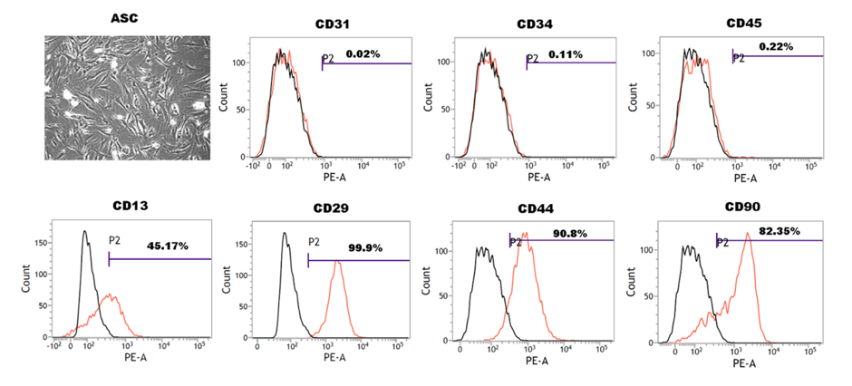
16
Result – Suppl. Fig. 2
Suppl. Fig. 2 A-B
[Purpose]
Isolation and characterization of ASC
Strain C57BL/6 Mouse Adipose-Derived Mesenchymal Stem Cells with GFP
Suppl. Fig. 2. Fluorescence-activated cell sorting analysis of ASC. Approximately 5 × 10⁵ cells were washed twice with PBS, and then incubated with phycoerythrin-conjugated rat anti-mouse CD31, CD34, CD45, CD13, CD29, CD44, and CD90 antibodies. PE rat IgG1, k isotype was used as controls. All antibodies were from BD science.
ASC were positive for the cluster of differentiation (CD) markers CD13, CD29, CD44, and CD90, but negative for endothelial cell marker CD31, hematopoietic cell marker CD34, and pan-leukocyte marker CD45.
Notes:
Strain C57BL/6 Mouse Adipose-Derived Mesenchymal Stem Cells with GFP
Derived from the adipose tissues at the inguen of qualified strain C57BL/6 mice and have been transfected with a lentiviral construct encoding a GFP expression motif.
These transgenic mice express enhanced Green Fluorescent Protein (GFP) under the direction of the human ubiqutin C promoter in all tissues examined. Certain hematapoetic cell types display distinct expression levels of GFP, allowing identification of different cells types by FACS analysis. This mutant mouse strain represents a useful tool in studies related to hematopoetic cell differentiation and in vivo tracking of leukocytes.
Although there is still no clear consensus on the antigen expression pattern that will define hASCs, a protocol is also presented for the flow cytometric analysis utilizing a series of antibody panels. The analysis of these surface epitope patterns can aide in the isolation and characterization of hASCs. Moreover, using this standardized antibody panel, direct comparisons can be made between ASCs isolated from various tissue sources, which will benefit the field by providing uniformity to the comparison process.

Slide 19
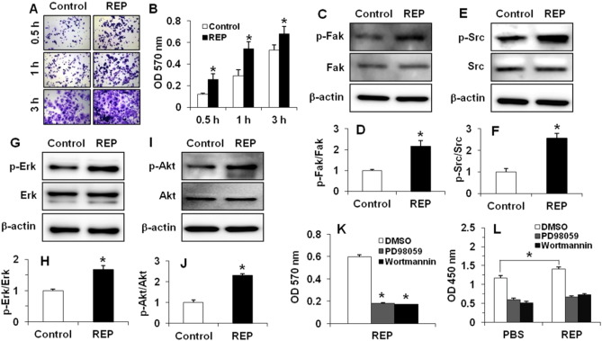
17
Result – Fig. 1
Fig. 1 A-L
[Purpose]
To investigate REP activates adhesion and survival signaling in ASC
Note:
Both Fak and Src signaling kinases are known to be activated when cells attach to the RGD motif of native ECM proteins.
Erk and Akt signaling molecules are major survival kinases mediating proliferation and survival pathways in various types of cells including ASC.
PD98059 and Wortmannin are highly specific in vitro inhibitors of Mek (Erk kinase) and PI3K (Akt kinase), respectively.
Fig. 1. REP matrix binds ASC and activates adhesion signaling kinases and enhances ASC viability through the activation of Mek/Erk and PI3K/Akt signaling pathways. (A) Representative micrographs of the crystal violet-stained cells attached to the uncoated control and REP-coated plates. Images were taken after 0.5 h, 1 h, and 3 h adhesion time. (B) Quantitative comparison of cell adhesion between REP and the control. (C) Western blot photograph of Fak phosphorylation. (D) p-Fak/Fak ratio. (E) Western blot image of Src phosphorylation. (F) p-Src/Src ratio. (G) Western blot image of Erk phosphorylation. (H) p-Erk/Erk ratio. (I) Western blot photograph of Akt phosphorylation. (J) p-Akt/Akt ratio. (K) Inhibition of ASC adhesion to REP by PD98059 or Wortmannin. (L) Inhibition of ASC viability by PD98059 or Wortmannin.
The interaction of ASC with REP upregulated phosphorylation of Fak and Src kinases and significantly increased Erk and Akt signal transduction in vitro.
Inhibition of Mek/Erk signaling by PD98059 or PI3K/Akt signaling by Wortmannin caused a marked decrease in cell adhesion and cell viability.
Notes:
When cells were allowed to attach to the 1 μM REP-coated culture plate for 0.5 h, 1 h, and 3 h, the percentage of cell adhesion to REP was approximately 216%, 185%, and 129% of attachment to untreated control plate, respectively. The phosphorylation statuses of Fak and Src in the cells attached to REP were measured, because both Fak and Src signaling kinases are known to be activated when cells attach to the RGD motif of native ECM proteins [32]. Western blot analysis showed that adhesion of cells to REP caused 2.2- and 2.7-folds increase in p-Fak/Fak (Fig. 1C, D) and p-Src/Src (Fig. 1E, F) ratios, respectively, compared to those values of the cells bound to the control plate.
In order to evaluate whether REP can modulate survival signaling pathways, the phosphorylation statuses of Erk and Akt were analyzed by Western blotting. These two signaling molecules are major survival kinases mediating proliferation and survival pathways in various types of cells including ASC [33]. The p-Erk/Erk (Fig. 1G, H) and p-Akt/Akt (Fig. 1I, J) ratios of the cells cultured on the 1 μM REP-coated plate were approximately 1.7- and 2.3-times greater than those of the cells grown on the control plate, respectively.

Slide 20
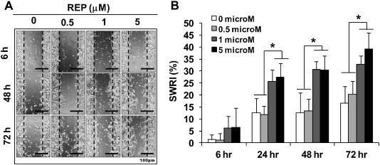
18
Result – Fig.2
Fig. 2 A-B
[Purpose]
To investigate the effect of REP on keratinocyte migration in vitro
Fig. 2. Accelerating effect of REP on keratinocyte migration. (A) Representative image of keratinocyte migration on polystyrene surface or the surfaces coated with 0.5, 1, and 5 μM REP during a 72-h culture period. (B) Quantitative relationship between REP concentration and SWRI. *p < 0.05.
The migration speed of keratinocyte accelerated in a REP concentration-dependent fashion.
The motility of keratinocytes was shown to be correlated with the dosage of RGD-functionalized REP.

Slide 21
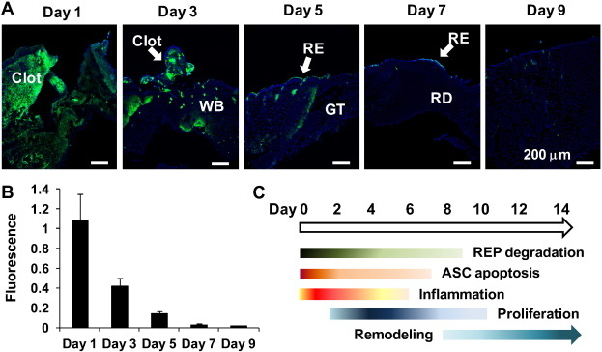
19
Result – Fig.3
Fig. 3 A-C
[Purpose]
To investigate biodegradability of REP from the site of injury in C57BL/6J mice
Fig. 3. Clearance of REP from the site of injury. (A) Fluorescence micrographs of tissue sections taken at days 1, 3, 5, 7, and 9 postwounding. (B) Decrease of the fluorescence intensity of Fam-REP during a 9-days healing period. (C) Schematic representation of the time courses of REP degradation and ASC apoptosis and the temporal progression of the wound healing phases. Pontamine Sky Blue 5BX was used to quench autofluorescence before mounting. WB = wound bed, GT = granulation tissue, RE = regenerated epidermis, RD = regenerated dermis. Green = Fam-REP. Blue = DAPI.
The grafted REP remained locally and did not disperse into the intact wound edges.
The majority of grafted REP was dissolved within 5 days and almost completely cleared by 9 days after surgery with a half-life of about 3 days.
The time span of clearance covered the inflammatory and proliferative phases, and partially overlaps with the initial stage of maturation phase of wound healing.

Slide 22
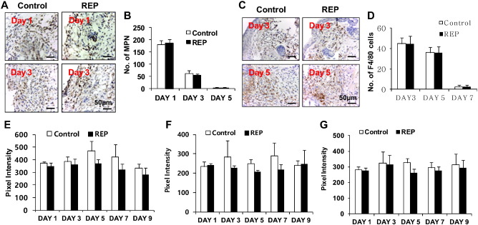
20
Result – Fig. 4
Fig. 4 A-G
[Purpose]
To investigate biocompatibility of REP in C57BL/6J mice
Fig. 4. Quantitative comparison of inflammatory cells and immunological cytokines in the REP-treated mice with the sham control mice. (A) Immunohistostaining photograph of myeloperoxidase-positive neutrophils (MPN). (B) Number of MPN measured at day 1, 3, and 5 postwounding. (C) Immunohistostaining image F4/80-positive macrophages. (D) Number of macrophages measured at day 3, 5, and 7 after surgery. Brown spots correspond to neutrophils and macrophages. (E), (F), and (G) show the relative concentration of TNF-α, IL-1β, and IL-12 in the sera collected 1, 3, 5, 7, and 9 days post surgery. Tissue sections and sera were obtained from the sham control and 100 μM REP-treated mice.
Excessive local inflammation did not occur after REP application.

Slide 23
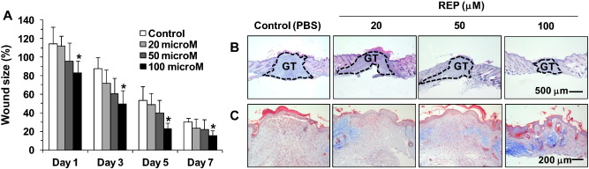
21
Result – Fig.5
Fig. 5 A-C
[Purpose] To investigate the effects of REP concentration on overall wound closure and dermal tissue regeneration in C57BL/6J mice
Fig. 5. Effects of REP concentration on overall wound closure and dermal tissue regeneration. (A) Wound size (%). *p < 0.05 compared to control. (B) H&E staining of wounds at 9 days after surgery. Black dot line outlines granulation tissue. (C) Collagen staining by Masson's trichrome. Area of collagen deposition was defined as the blue colored region in the space between hyperproliferative epithelium and panniculus carnosus muscle layer.
Wound closure occurred with faster kinetics following REP administration.
Histological analyses indicated a fast transition of granulation tissue into a collagen-rich dermal tissue in the presence of REP.

Slide 24
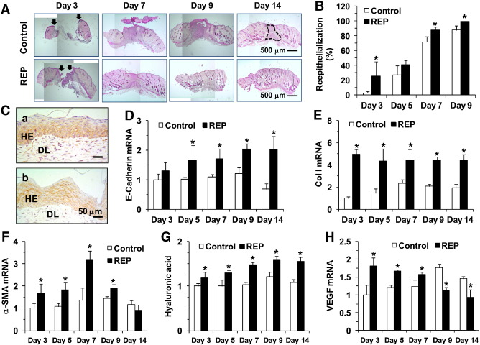
22
Result – Fig. 6
Fig. 6 A-H
[Purpose] To investigate the effects of 100 μM REP on overall wound closure and dermal tissue regeneration in C57BL/6J mice
Note:
E-cadherin is a major component of adherens junctions in the epidermis.
Alpha-smooth muscle actin (α-SMA) is commonly used as a marker of myofibroblast formation
Following REP treatment, skin tissue regeneration occurred through increased restoration of dermal and epidermal components, not merely by contracting wound edges.
Fig. 6. Comparison of overall wound healing between the control group and 100 μM REP group. (A) Representative H&E microscopic images of the control wounds and REP-treated wounds. Arrows indicate the edges of epithelial tongues. At day 14, there was still indication of granulation tissue (black dot line) in the dermis of the control wound. (B) Percent change in reepithelialization. *p < 0.05 compared to control. (C) Immunostaining of E-cadherin in the sham group (a) and the REP group (b). HE = hyperproliferative epithelium. DL = dermal layer. (D) E-cadherin mRNA expression. (E) Collagen I mRNA expression. (F) α-SMA mRNA expression. (G) Content of hyaluronic acid determined by ELISA. (H) VEGF mRNA expression. *p < 0.05 compared to control.

Slide 25
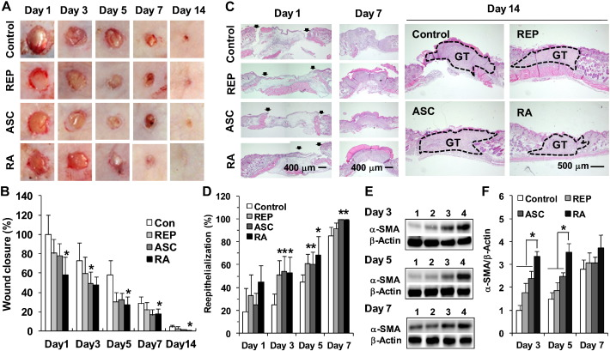
23
Result – Fig.7
Fig. 7 A-F
[Purpose] To investigate the wound healing progression among the sham control, REP, ASC, and RA groups over a 2-week period in nude mice
The rate of wound closure increased from the REP group to the ASC group, and to the RA group.
Histological analysis of the H&E-stained wound sections indicated that the restoration of epidermal and dermal tissues occurred faster in the ASC group than in the other groups at days 1 and 14
Although statistical significance was not achieved, it appeared there was a trend toward a better reepithelialization in the mice treated with RA than the REP and ASC groups.
Western blot analysis showed that α-SMA content was highest in the RA group, meaning that this group had the highest myofibroblast population.
α-SMA content in RA- treated wounds on days 3, 5, and 7 was 1.4-, 1.4-, and 1.2-fold greater, respectively, relative to α-SMA content in wounds treated with only ACS.
Fig. 7. Comparison of wound healing progression among the sham control, REP, ASC, and RA groups over a 2-week period. (A) Macroscopic monitoring of wound healing.(B) Percent change in wound closure. (C) Microscopic pictures of H&E-stained tissue specimens. Arrows mark the ends of epithelial tongues. GT = granulation tissue. (D) Percent change in reepithelialization. *p < 0.05 compared to control. (E) Western blot analysis of α-SMA protein expression. Lanes 1, 2, 3, and 4 correspond to sham control, REP, ASC, and RA groups, respectively. (F) Time-course change in α-SMA content determined by Western blot analysis shown in D. *p < 0.05.

Slide 26
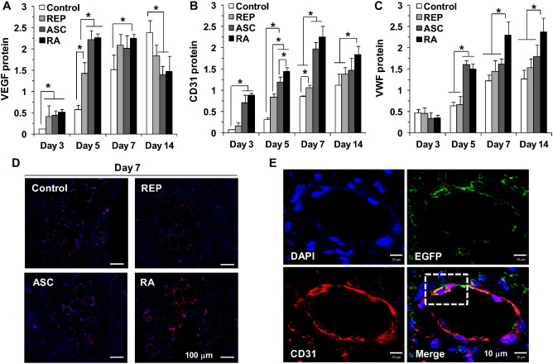
24
Result – Fig.8
Fig. 8 A-E
[Purpose] To investigate the effects of REP, ASC, and RA on the production of angiogenic factors and on new blood vessel formation
Implanted REP induced higher expression of VEGF, CD31, and VWF, and also promoted new blood vessel formation.
The combination of REP and ASC resulted in a more prominent microvas- culature as compared to treatment with ASC alone
in a tissue section of RA, a single cell in a cross section of newly formed vascular tube exhibited a clear overlap of CD31 and EGFP probes, suggesting a possibility of in situ differentiation of ASC into a vascular endothelial cell type and direct engraftment into the vasculature.
Fig. 8. Effects of REP, ASC, and RA on the production of angiogenic factors and on new blood vessel formation. (A) VEGF content. (B) CD31 amount. (C) VWF abundance. In (A), (B), and (C), protein content was quantified by ELISA. *p < 0.05. (D) Microvasculatures visualized at 7 days after surgery by immunofluorescence staining of endothelial cell marker CD31 (red color). Blue color = DAPI. (E) EGFP/CD31 immunofluorescence colocalization analysis of RA-treated tissue section at 7 days postsurgery. Yellow stain in white dotted line represents a cell positive for both ASC and endothelial phenotype.
Notes:
After five days, both endothelial cells (PECAM-1+ ) and supporting pericytes (both NG2+ and PDGFR+; refs 45,46; Fig. 5c) were present within the MAP scaold, whereas only single branches of endothelial cells without supporting pericytes were present in the non-porous bilateral controls (Fig. 5b)
The green fluorescent protein (GFP). The recombinant EGFP is expressed and purified from transformed E. coli

Slide 27
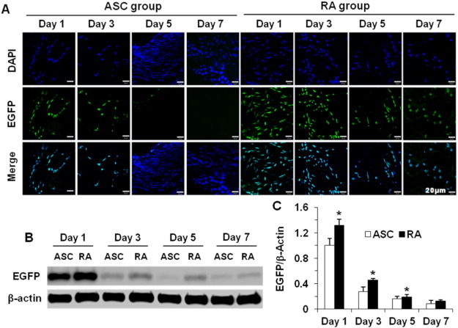
25
Result – Fig.9
Fig. 9 A-C
[Purpose] To investigate the effect of REP on the survival of transplanted ASC
>90% of the implanted ASC were dead within 5 days, with a massive cell death occurring within 5 days.
The combined therapy of REP and ASC resulted in a 35% improve- ment in cell viability at 1 week after surgery.
Fig. 9. Effect of REP on the survival of transplanted ASC. Twenty four nude mice were divided into two groups. Under sterile condition, 2 pairs of 6-mm circular, full-thickness wounds were made on the left and right dorsal skin of a nude mouse. Three mice were sacrificed at a specified day for each group.(A) Fluorescence micrographs of EGFP-positive cells in ASC- and RA-treated wound beds. (B) Western blot analysis of EGFP extracted from the ASC and RA groups. (C) Time course of the decrease in EGFP intensity. Y axis represents the ratio of EGFP fluorescence intensity extracted from a tissue sample to that extracted from 1 × 10⁶ ASC. *p < 0.05 compared to control.
Notes:
Anti-Mouse CD11b Purified
Also known as: Integrin alpha M, ITGAM, Mac-1 alpha (Mac1A), Complement Receptor 3 alpha (CR3A)
The M1/70 monoclonal antibody reacts with mouse CD11b, the 165-170 kDa integrin α_{M}. CD11b non-covalently associates with CD18 to form α_{M}β₂ integrin (Mac-1) and binds to CD54 (ICAM-1), C3bi, and fibrinogen. Mac-1 is expressed by macrophages, NK cells, granulocytes, activated lymphocytes and mouse B-1 cells in the peritoneal cavity. M1/70 is also cross-reactive to human CD11b, and can be used for the detection of this antigen on human peripheral blood monocytes, granulocytes, and a subset of NK cells. Through interactions with its ligands, CD11b participates in adhesive cell interactions.

Slide 28
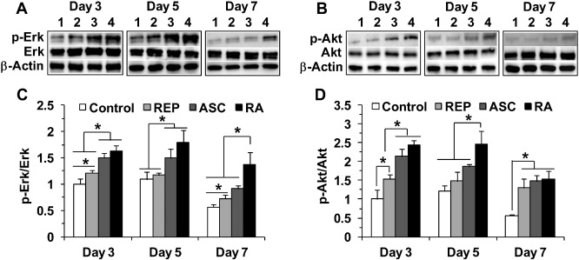
26
Result – Fig.10
Fig. 10 A-D
[Purpose] To investigate Erk and Akt phosphorylation during wound repair among the sham control, REP, ASC, and RA groups
Fig. 10. Comparison of Erk and Akt phosphorylation during wound repair among the sham control, REP, ASC, and RA groups. (A) Western blot image of Erk phosphorylation. (B) Western blot photograph of Akt phosphorylation. In A and B, lanes 1, 2, 3, and 4 correspond to sham control, REP, ASC, and RA groups. (C) Time course change in p-Erk/Erk ratio. (D) Time course change in p-Akt/Akt ratio. *p < 0.05.
The interaction of ASC with REP significantly increased Erk and Akt signal transduction during wound healing.

Slide 29
27
Conclusion
CONCLUSION
In conclusion, of the most significant among these findings is the successful implementation of thermoreversible, integrin-binding REP as not only an alternative matrix for replacing of damaged or lost natural ECM, but also as an effective carrier for embedding ASC and enhancing the subsequent in vivo viability of transplanted ASC. A combined therapy of REP and ASC enhances wound healing and regeneration with a clinically noticeable effect. Because the mechanisms for the influence of REP on the combined therapy are through the mobilization of endogenous cells, stimulation of local angiogenesis, and enhancement of engrafted stem cell viability, this mechanistic insight on the REP-mediated delivery system might identify new therapeutic targets that can promote normal tissue regeneration in impaired healing conditions such as chronic neurodegenerative diseases and diabetic ulcers.

Slide 30
28
Summary
In situ gelling of REP matrix/adipose stem cells
composite within excisional wound space
Biosynthesis of
dermal components
Enhanced efficacy of stem
cell-assisted wound repair
Recruitment of
endogenous cells
Reepithelization
Survival of
tranplanted stem cells
Angiogenesis
One crucial issue in stem cell therapy used for tissue repair is often the lack of selective carriers to deliver stem cells to the site of injury where the native extracellular matrix is pathologically damaged or lost. Therefore, it is necessary to develop a biomaterial that is permissive to stem cells and is suitable to replace injured or missing matrix. The major aim of this study is to investigate the potential of an RGD-containing elastin-like polypeptide (REP) with the structure TGPG[VGRGD(VGVPG)₆]₂₀WPC to engraft adipose stem cells (ASC) to full-thickness excisional wounds in mice. We implanted REP into the wound defects via body temperature-induced in situ aggregation. Engrafted REP exhibited a half-life of 2.6 days in the wounds and did not elicit any pathological immune responses. REP itself significantly accelerated wound closure and reepithelialization and upregulated the expression of dermal tissue components. A combined administration of REP and ASC formed a hydrogel-like ASC/REP composite, which provided better neovascularization than the use of ASCs alone and increased the viability of transplanted ASC, improving overall wound healing. In vitro and in vivo mechanistic investigations suggested that REP enhances ASC survival at least in part via the Fak/Src adhesion-induced upregulation of Mek/Erk and PI3K/Akt survival pathways. We conclude that REP is a promising therapeutic agent for the improvement of stem cell-based therapy for enhanced tissue regeneration and repair.

Slide 31
Additional slides

Slide 32
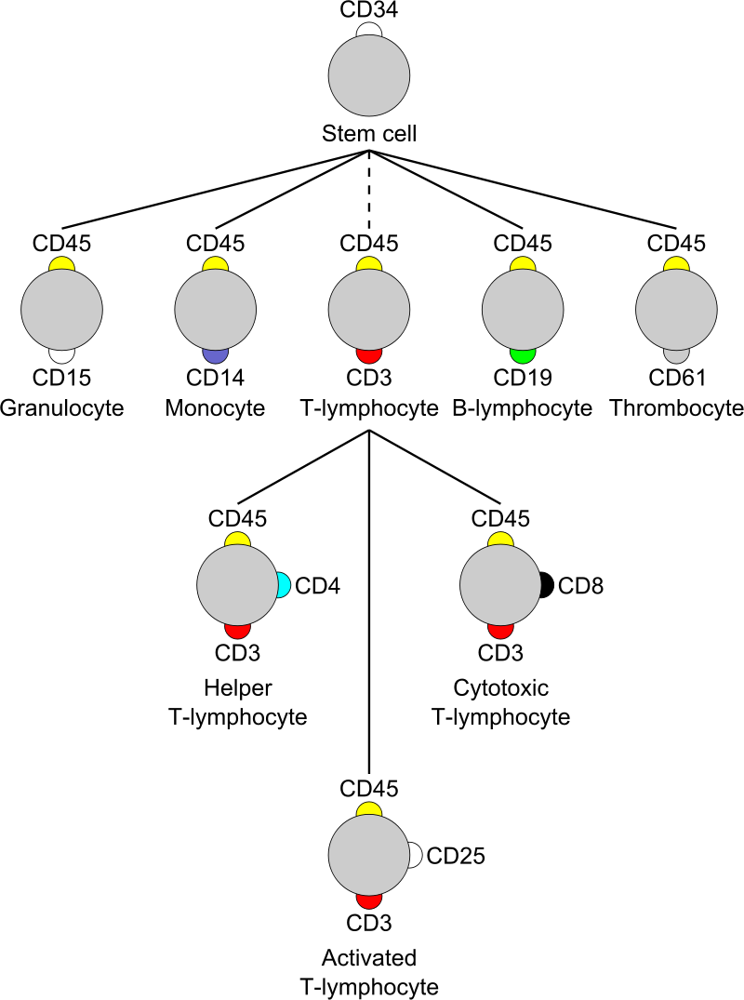
CD13, aminopeptidase
CD29, integrin β1
CD31, platelet endothelial cell adhesion molecule; CD34, hematopoietic progenitor cell antigen CD34;
CD44 antigen
CD90, Thy-1 membrane glycoprotein

Slide 33
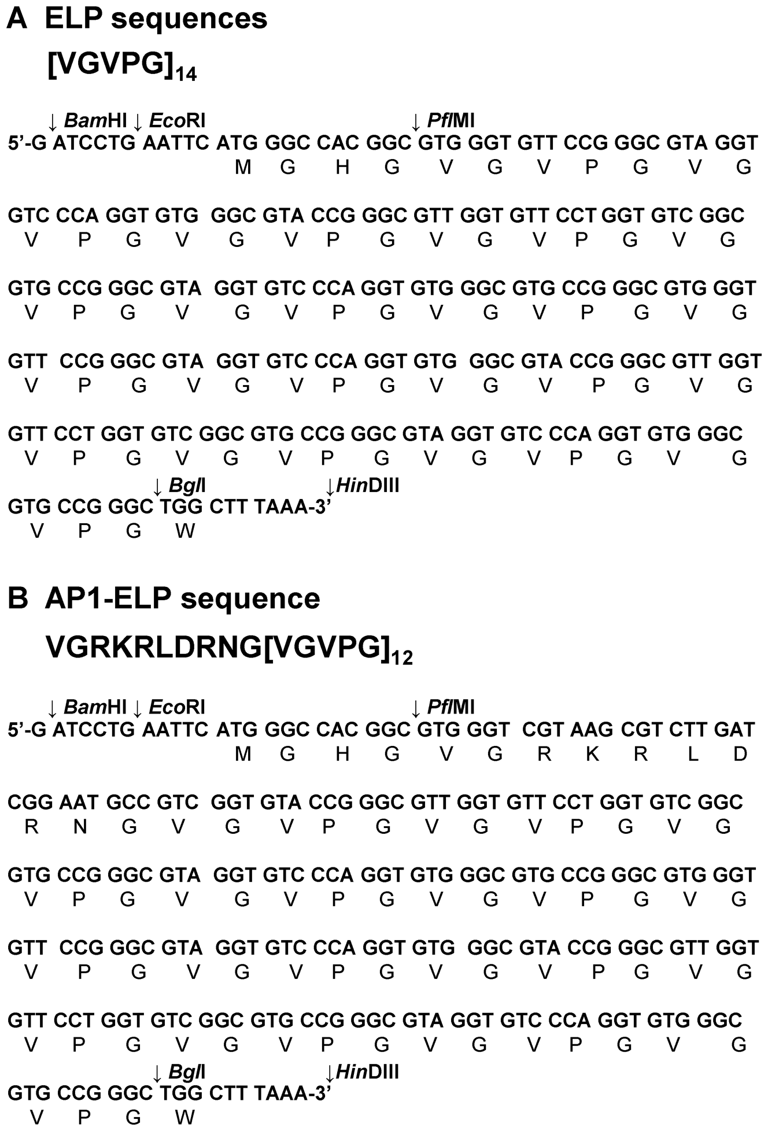
Figure 1. Monomer genes of V₁₄ and AP1-V₁₂.
(A) [VGVPG]₁₄ and (B) VGRKRLDRNG[VGVPG]₁₂ monomeric genes and their corresponding polypeptide sequences.

Slide 34
SGPG[VGRKRLDRNG(VGVPG)₁₂]₆WPC
Agarose gel electrophoresis of (A) [V₁₄]_{n} and (B) [AP1-V₁₂]_{n}, (n = 1, 2, 4, 5 and 6) represents the number of monomer-gene repeats, visualized by ethidium bromide staining.
Notes:
The left lane contains a 1-kb DNA size marker. pRSET vectors containing ELP genes were double digested with BamH I and HinD III, producing two bands corresponding to the vector (2900 bp) and variable-sized ELPs. The number of monomer-gene repeats (1, 2, 4, 5 and 6) is labeled on top, and expected ELP sizes are given on the right. (C) Partial sequence consists of Sfi I site, used for pET25b+ vector modification. (D) [V₁₄]₆ and (E) [AP1-V₁₂]₆ genes digested with PflM I and Bgl I were ligated to Sfi I-digested, modified pET 25b+ vector. The sizes of DNAs were confirmed by double digestion with Nde I and HinD III. Two bands corresponding to the vector (5547 bp) and ELP gene (1294 bp) were produced.
doi:10.1371/journal.pone.0081891.s001

Slide 35
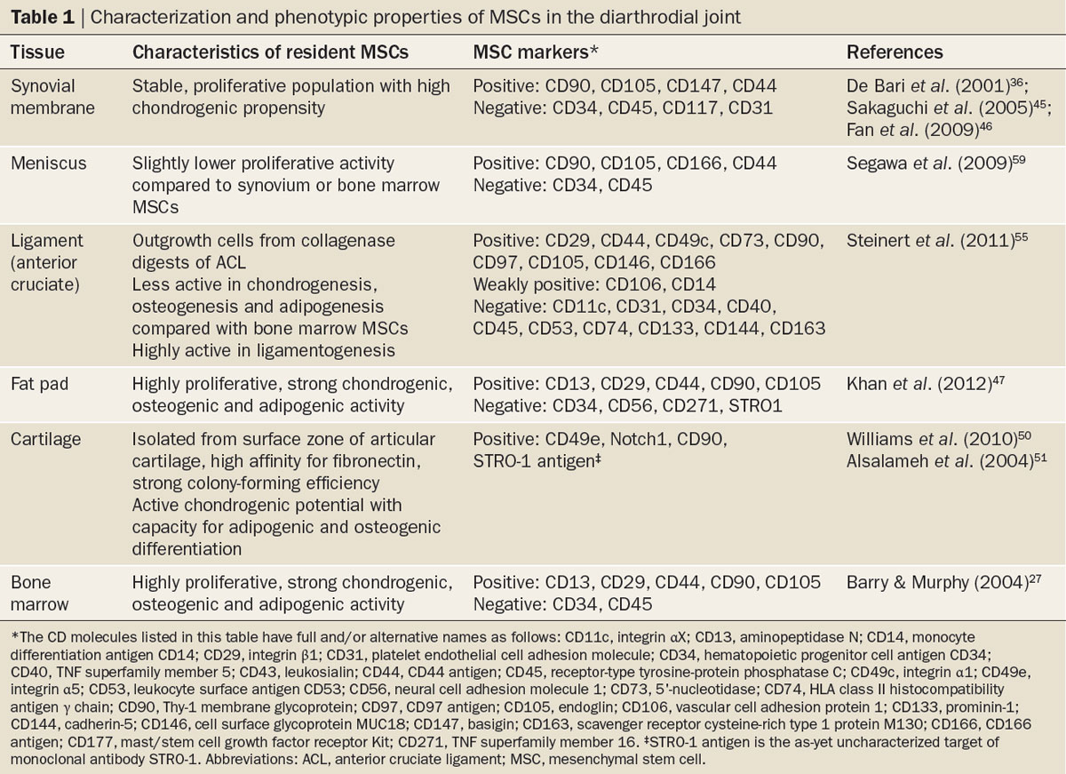

Table 1 Characterization and phenotypic properties of MSCs
in the diarthrodial joint
Barry, F. & Murphy, M. (2013) Mesenchymal stem cells in joint disease and repair
Nat. Rev. Rheumatol. doi:10.1038/nrrheum.2013.109

Slide 36
Table 1. A presentation of GEPBP
Class | Description | Structure | Physicochemical properties | References
Elastin-like polypeptides (ELP) | Polymers containing repeats of the elastin sequence | [VPGXG]_{n}, (X = every amino acid, with the exception of proline) | Chains changing their structure in response to changes in ambient temperature | Gagner et al. (2014)
Silk-elastin like protein polymers (SELP) | Block copolymers made of silk and elastin subunits | [(GAGAGS)_{m}(GVGXP)_{n}]_{o} (X = every amino acid, with the exception of proline) | Possibility of creating cross-linked hydrogels | Gustafson and Ghandehari (2010)
Poly [(AG)₃PEG] (Intein-triggered protein hydrogel) | Polymers made of repeats of nonapeptides (AG)₃PEG | [(AG)_{m}PEG]_{n} | Amorphous water-soluble crystals | Ramirez et al. (2013)
Poly (CS₅ELP) (Elastin-like Artificial Extracellular Matrix Proteins-Fibronectin CS5 Domains) | Elastin-like blocks separated by sequences of fibronectin | [(GEEIQIGHIPREDVDYHLYP)(GVGXP)_{m}]_{n}(X = every amino acid, with the exception of proline) | Conformational changes in response to changes in ambient temperature | Panitch et al. (1999)
Poly ‘‘EAK’’ (Poly “Glutamic acid, Alanine, Lysine”) | Polymer repeats of EAK amino acids | [AEAEAKAK]_{n} | Amyloid-like, highly stable β-sheet fibrils | Saiani et al. (2009)

Slide 37
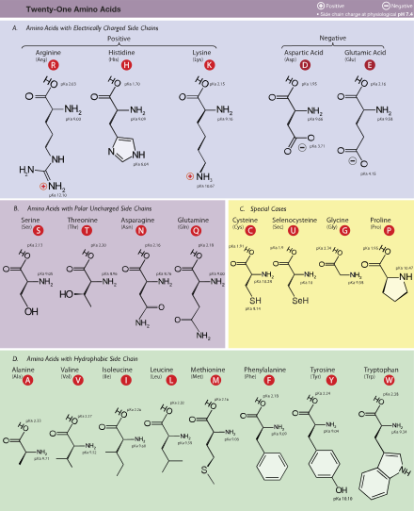

Slide 38
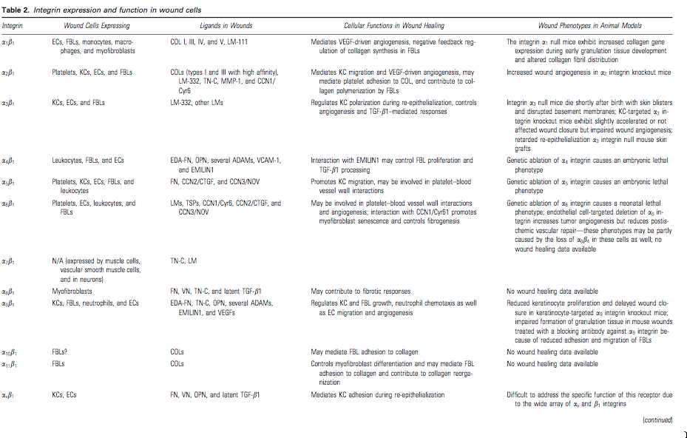

Slide 39
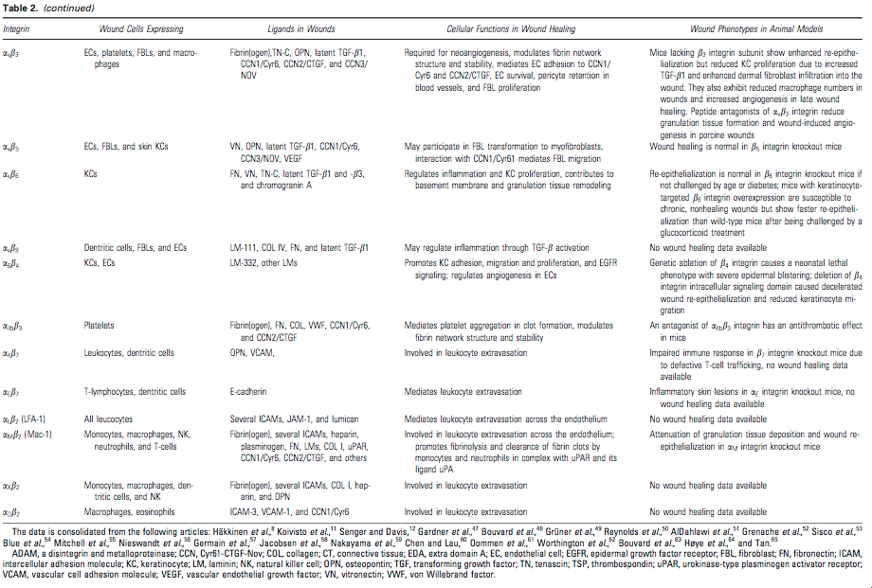

Slide 40
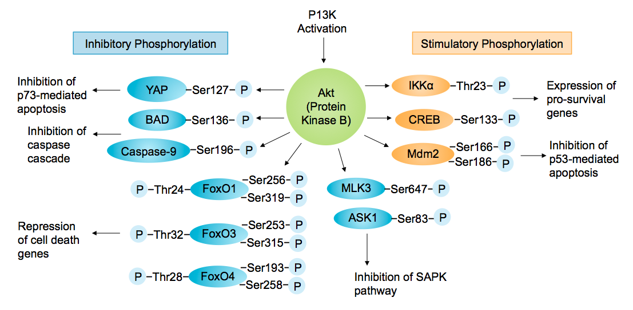

Slide 41
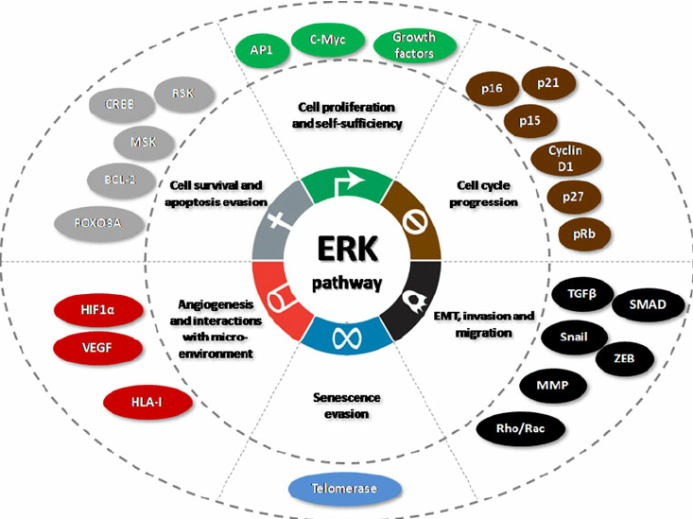

Slide 42
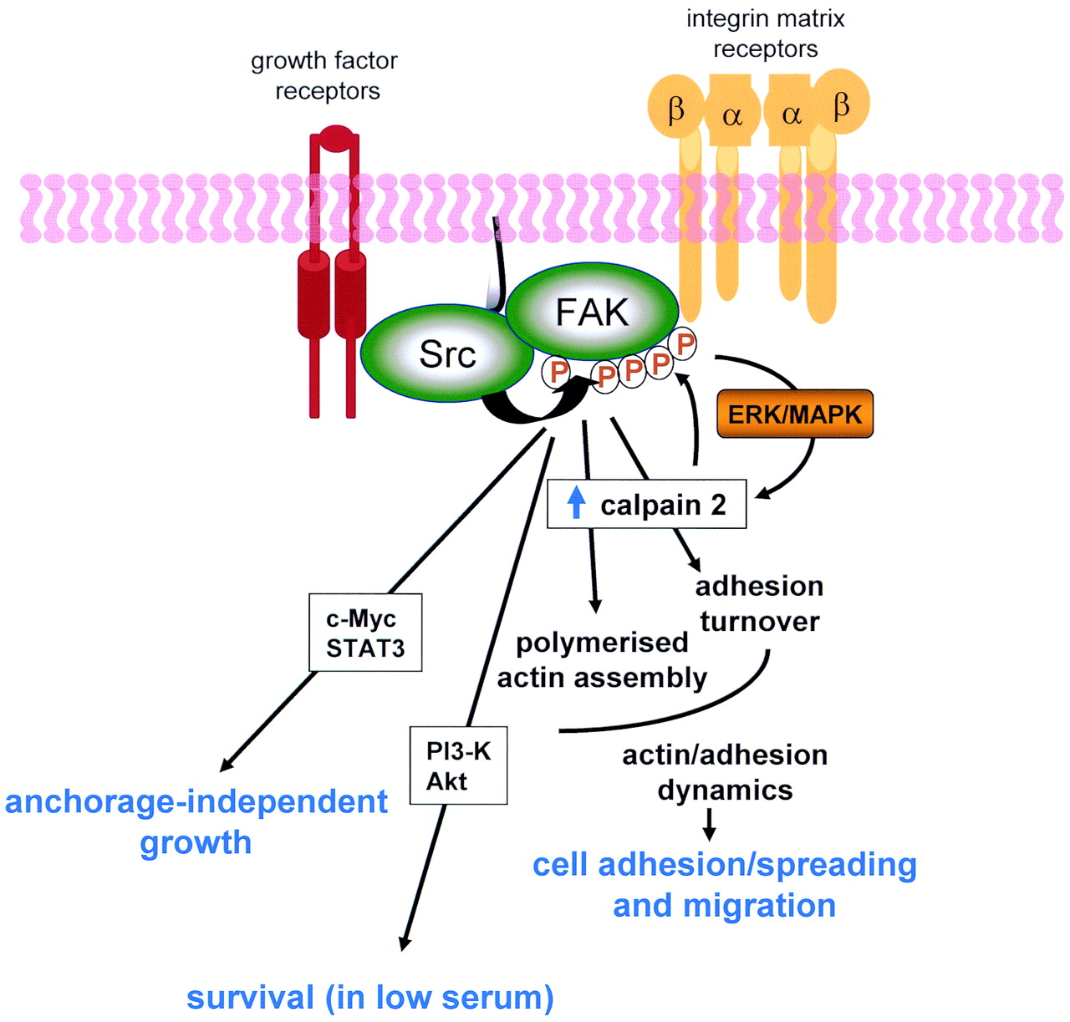

Slide 43
